Slide 1

OBJECT ORIENTED DESIGN AND PROGRAMMING(21CSCS101T)
Arvind Kumar

Slide 2
Software Evaluation

Slide 3
1,0
Machine Language
Assembly Language
Procedure Oriented
Object Oriented Programming

Slide 4
Introduction & History

Slide 5
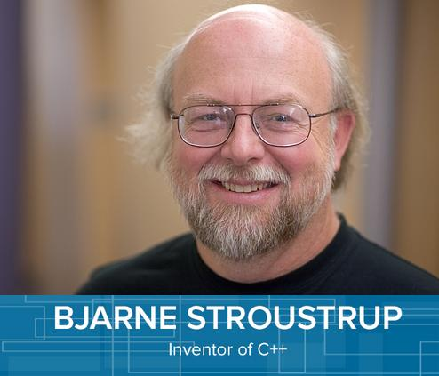
C++ is an object oriented programming language. It was developed by Bjarne Stroustrup at AT & T Bell’s Laboratory in 1979 at Murray Hill, New Jersey, USA.

Slide 6
Bjarne Stroustrup was an admirer of Simula67 and a strong supporter of C programming. So he combined both the language and generated a new language known as C++ Programming.
Initially, it was called “C with Classes”. However, in 1983, the name was changed to C++.
The idea of C++ comes from the C increment operator ++, therefore, C++ is an incremented version of C Programming.

Slide 7
C++ is a superset of C. Therefore, almost all C programs are also C++ programs.
The most important facilities that C++ adds on to C are classes, Inheritance, function overloading and operator overloading.

Slide 8
Procedure Oriented Programming

Slide 9
Conventional programming, using high level languages such as COBOL, FORTRAN and C is commonly known as Procedure Oriented Programming (POP).

Slide 10
Characteristics of POPs:
Emphasis is on doing things (algorithms).
Large Programs are divided into smaller programs known as functions.
Most of the functions share global data.
This is one of the changes introduced by ANSI C++.

Slide 11
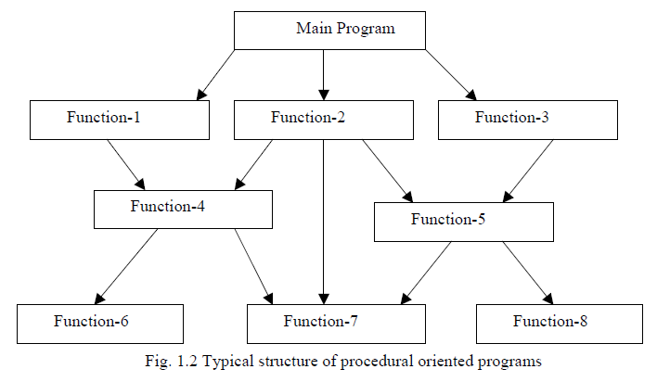

Slide 12
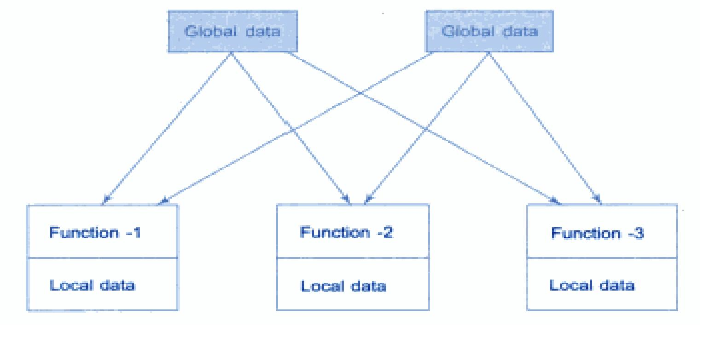

Slide 13
Data move openly around the system from function to function.
Function transform data from one form to another.
Employs top down approach in program design.

Slide 14
Steps in learning C++ language:
C++ Character Set
Constants
Variables
Keywords
Instructions
Program

Slide 15
Thank You

